Slide 1
[AI Theory&App] 02 NNBasic
Instructor: Hao-Shang Ma
Department Of Computer Science And Information Engineering, NTUST

Slide 2
Introduction to Neural Networks

Slide 3


A Brief Example of Neural Networks
$$x_{1}$$
$$x_{2}$$
$$x_{3}$$
$$x_{4}$$
.
.
.
.
.
.
.
$$x_{256}$$
$$y_{1}$$
$$y_{2}$$
$$y_{3}$$
$$y_{4}$$
.
.
.
.
.
.
.
$$y_{10}$$
is 1
is 2
is 3
is 4
…
Neural Network
is 10
Input: 256-dim vector
Output: 10-dim vector

Slide 4

Basic Artificial Neural Network
input
output
$$hidden layer$$

Slide 5
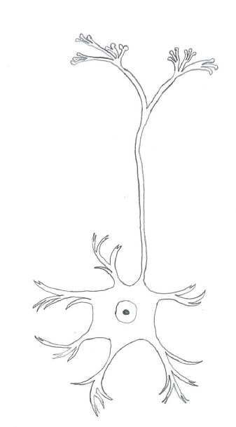





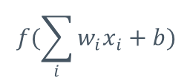


Neuron Design
Output signal
Input signal
$$x_{0}$$
$$w_{0}$$
axon from a neuron
synapse
$$w_{0}x_{0}$$
axon from a neuron
$$f(\sum_{i}{w_{i}x_{i}+b})$$
$$w_{1}x_{1}$$
cell body
$$\sum_{i}{w_{i}x_{i}+b}$$
$$f$$
output axon
activation
function
$$w_{2}x_{2}$$

Slide 6




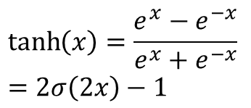
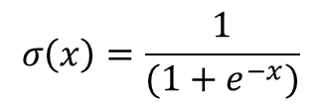

Activation Function for Neurons
graphs
Sigmoid
tanh
ReLU
$$σ\left(x\right)=\frac{1}{(1+e^{−x})}$$
$$\tanh\left(x\right)=\frac{e^{x}−e^{−x}}{e^{x}+e^{−x}} \\ =2σ\left(2x\right)−1$$
equations
$$ReLU\left(x\right)=max⁡(0,x)$$
ranges
$$0<σ\left(x\right)<1$$
$$−1<tanh\left(x\right)<1$$
$$0<ReLU\left(x\right)<1$$

Slide 7
How to Let NNs Work Better
Something you need to consider first
What activation function should I use
How many neurons do I need
How many layers should I need
More advanced
What kind of network structure should I use (CNN, RNN, GAN, etc.)

Slide 8


Deep Neural Network
Deep: more hidden layers
…
output
input
input
output
$$hidden layers$$
$$hidden layer$$

Slide 9
The Deeper the Better?
Without DL
AlexNet
With DL
Error rate of experts
Olga Russakovsky*, Jia Deng*, Hao Su, Jonathan Krause, Sanjeev Satheesh,
Sean Ma, Zhiheng Huang, Andrej Karpathy, Aditya Khosla, Michael Bernstein,
Alexander C. Berg and Li Fei-Fei.
ImageNet Large Scale Visual Recognition Challenge. IJCV, 2015.

Slide 10


How to Train the NNs
Input some examples
Calculate the output
Forward propagation
Measure the errors between the outputs and answers
Update the weights in NN
Back propagation
input
$$hidden layer$$
output
input
$$hidden layer$$
output

Slide 11













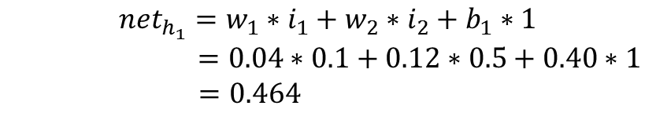







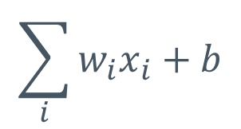








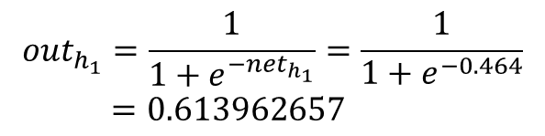

Forward Propagation
$$0.1$$
$$i_{1}$$
$$.04$$
$$w_{1}$$
$$h_{1}$$
$$.40$$
$$w_{5}$$
$$o_{1}$$
$$\sum_{i}{w_{i}x_{i}+b}$$
$$.16$$
$$w_{2}$$
$$.45$$
$$w_{6}$$
$$i_{2}$$
$$.12$$
$$w_{3}$$
$$h_{2}$$
$$.50$$
$$w_{7}$$
$$o_{2}$$
$$0.5$$
$$.08$$
$$w_{4}$$
$$.55$$
$$w_{8}$$
$$b_{1}$$
$$.40$$
$$b_{2}$$
$$.60$$
$${net}_{h_{1}}=w_{1}∗i_{1}+w_{2}∗i_{2}+b_{1}∗1$$
$$=0.04∗0.1+0.12∗0.5+0.40∗1$$
$=0.464$
$${out}_{h_{1}}=\frac{1}{1+e^{−{net}_{h_{1}}}}=\frac{1}{1+e^{−0.464}}$$
$=0.613962657$
$${out}_{h_{2}}=0.611114647$$

Slide 12







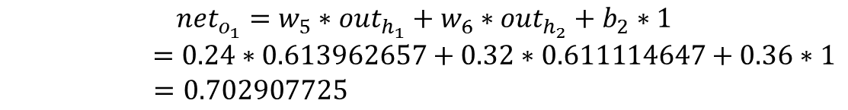




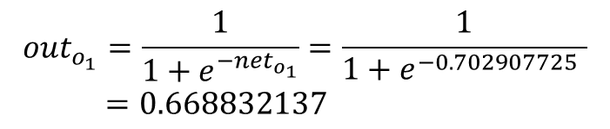
Forward Propagation
$$i_{1}$$
$$.15$$
$$w_{1}$$
$$h_{1}$$
$$.24$$
$$w_{5}$$
$$o_{1}$$
$$\sum_{i}{w_{i}x_{i}+b}$$
$$.20$$
$$w_{2}$$
$$.28$$
$$w_{6}$$
$$i_{2}$$
$$.25$$
$$w_{3}$$
$$h_{2}$$
$$.32$$
$$w_{7}$$
$$o_{2}$$
$$.30$$
$$w_{4}$$
$$.20$$
$$w_{8}$$
$$b_{1}$$
$$.35$$
$$b_{2}$$
$$.36$$
$${net}_{o_{1}}=w_{5}∗{out}_{h_{1}}+w_{6}∗{out}_{h_{2}}+b_{2}∗1$$
$$=0.24∗0.613962657+0.32∗0.611114647+0.36∗1$$
$=0.702907725$
$${out}_{o_{1}}=\frac{1}{1+e^{−{net}_{o_{1}}}}=\frac{1}{1+e^{−0.702907725 }}$$
$=0.668832137$
$${out}_{o_{2}}=0.657941101$$

Slide 13


















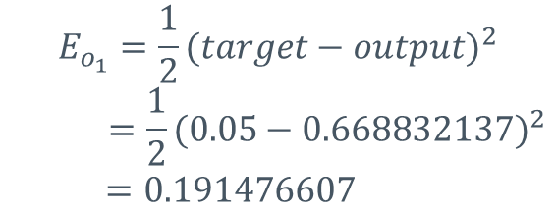




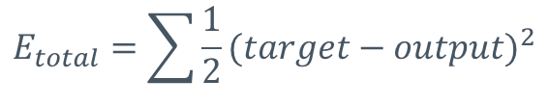
The Errors of Outputs
$$i_{1}$$
$$.04$$
$$w_{1}$$
$$h_{1}$$
$$.24$$
$$w_{5}$$
$$o_{1}$$
$$.05$$
$$E_{total}=\sum{\frac{1}{2}{(target−output)}^{2}}$$
$$.16$$
$$w_{2}$$
$$.28$$
$$w_{6}$$
$$i_{2}$$
$$.12$$
$$w_{3}$$
$$h_{2}$$
$$.32$$
$$w_{7}$$
$$o_{2}$$
$$.08$$
$$w_{4}$$
$$.20$$
$$w_{8}$$
$$.95$$
$$b_{1}$$
$$.40$$
$$b_{2}$$
$$.36$$
$$E_{o_{1}}=\frac{1}{2}{(target−output)}^{2}$$
$$=\frac{1}{2}{(0.05−0.668832137)}^{2}$$
$=0.191476607$
The total error for the neural network is the sum of these errors:
$$E_{total}=E_{o_{1}}+E_{o_{2}}=0.191476607+0.042649200=0.234125807$$

Slide 14
Updating Weights
The only layer with the answer is the output layer
The only layer we can know the errors
We need to update the weights from the output layer to hidden layers
Solution: Back-propagation

Slide 15
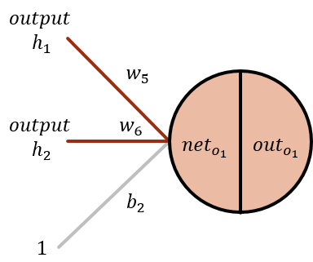
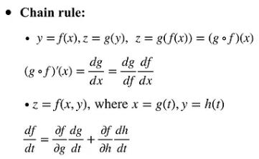


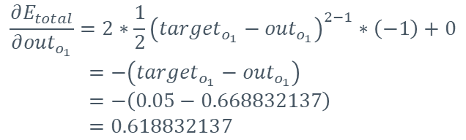



Backward Propagation to Update w5
Output layer
$$i_{1}$$
$$.04$$
$$w_{1}$$
$$h_{1}$$
$$.24$$
$$w_{5}$$
$$o_{1}$$
$$.05$$
$$.16$$
$$w_{2}$$
$$.28$$
$$w_{6}$$
$$i_{2}$$
$$.12$$
$$w_{3}$$
$$h_{2}$$
$$.32$$
$$w_{7}$$
$$o_{2}$$
$$.08$$
$$w_{4}$$
$$.20$$
$$w_{8}$$
$$.95$$
$$b_{1}$$
$$.40$$
$$b_{2}$$
$$.36$$
loss
activate
weight
$$\frac{∂E_{total}}{∂w_{5}}=\frac{∂E_{total}}{∂{out}_{o_{1}}}∗\frac{∂{out}_{o_{1}}}{∂{net}_{o_{1}}}∗\frac{∂{net}_{o_{1}}}{∂w_{5}}$$
$$E_{total}=\frac{1}{2}{(target−{out}_{o_{1}})}^{2}+\frac{1}{2}{(target−{out}_{o_{2}})}^{2}$$
$$\frac{∂E_{total}}{∂{out}_{o_{1}}}=2∗\frac{1}{2}{\left({target}_{o_{1}}−{out}_{o_{1}}\right)}^{2−1}∗\left(−1\right)+0$$
$=−\left({target}_{o_{1}}−{out}_{o_{1}}\right)$
$=−\left(0.05−0.668832137\right)$
$=0.618832137$

Slide 16
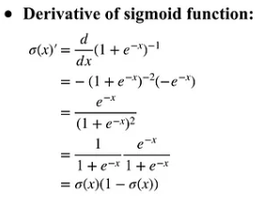
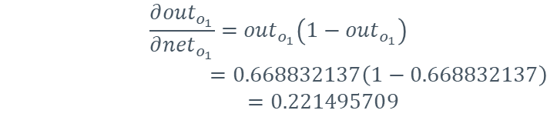


Backward Propagation to Update w5
Output layer
$$i_{1}$$
$$.04$$
$$w_{1}$$
$$h_{1}$$
$$.24$$
$$w_{5}$$
$$o_{1}$$
$$.05$$
$$.16$$
$$w_{2}$$
$$.28$$
$$w_{6}$$
$$i_{2}$$
$$.12$$
$$w_{3}$$
$$h_{2}$$
$$.32$$
$$w_{7}$$
$$o_{2}$$
$$.08$$
$$w_{4}$$
$$.20$$
$$w_{8}$$
$$.95$$
$$b_{1}$$
$$.40$$
$$b_{2}$$
$$.36$$
$$\frac{∂E_{total}}{∂w_{5}}=\frac{∂E_{total}}{∂{out}_{o_{1}}}∗\frac{∂{out}_{o_{1}}}{∂{net}_{o_{1}}}∗\frac{∂{net}_{o_{1}}}{∂w_{5}}$$
$${out}_{o_{1}}=\frac{1}{1+e^{−{net}_{o_{1}}}}$$
$$\frac{∂{out}_{o_{1}}}{∂{net}_{o_{1}}}={out}_{o_{1}}\left(1−{out}_{o_{1}}\right)$$
$$=0.668832137\left(1−0.668832137\right)$$
$$=0.221495709$$
Notes:
透過微分，了解變數對於輸出的影響程度

Slide 17
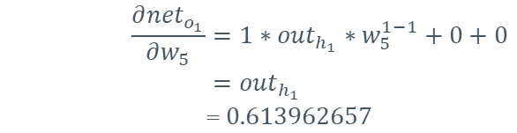



Backward Propagation to Update w5
Output layer
$$i_{1}$$
$$.04$$
$$w_{1}$$
$$h_{1}$$
$$.24$$
$$w_{5}$$
$$o_{1}$$
$$.05$$
$$.16$$
$$w_{2}$$
$$.28$$
$$w_{6}$$
$$i_{2}$$
$$.12$$
$$w_{3}$$
$$h_{2}$$
$$.32$$
$$w_{7}$$
$$o_{2}$$
$$.08$$
$$w_{4}$$
$$.20$$
$$w_{8}$$
$$.95$$
$$b_{1}$$
$$.40$$
$$b_{2}$$
$$.36$$
$$\frac{∂E_{total}}{∂w_{5}}=\frac{∂E_{total}}{∂{out}_{o_{1}}}∗\frac{∂{out}_{o_{1}}}{∂{net}_{o_{1}}}∗\frac{∂{net}_{o_{1}}}{∂w_{5}}$$
$${net}_{o_{1}}=w_{5}∗{out}_{h_{1}}+w_{6}∗{out}_{h_{2}}+b_{2}∗1$$
$$\frac{∂{net}_{o_{1}}}{∂w_{5}}=1∗{out}_{h_{1}}∗w_{5}^{1−1}+0+0$$
$$={out}_{h_{1}}$$
$$=0.613962657$$

Slide 18
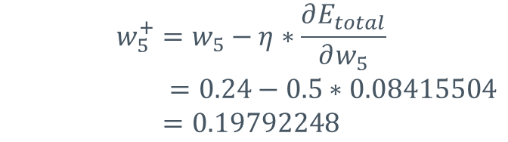
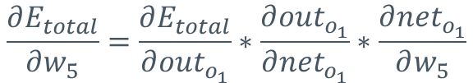



Backward Propagation to Update w5
Output layer
$$\frac{∂E_{total}}{∂w_{5}}=\frac{∂E_{total}}{∂{out}_{o_{1}}}∗\frac{∂{out}_{o_{1}}}{∂{net}_{o_{1}}}∗\frac{∂{net}_{o_{1}}}{∂w_{5}}$$
$$\frac{∂E_{total}}{∂w_{5}}=0.618832137∗0.221495709∗0.613962657=0.08415504$$
$$w_{5}^{+}=w_{5}−η∗\frac{∂E_{total}}{∂w_{5}}$$
$$=0.24−0.5∗0.08415504$$
$$=0.19792248$$
Learning rate
$$w_{6}^{+}=0.238117666$$
$$w_{7}^{+}=0.300177638$$
$$w_{8}^{+}=0.300084039$$

Slide 19









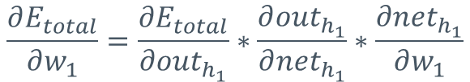


Backward Propagation to Update w1
Hidden layer
$$i_{1}$$
$$w_{1}$$
$$net$$
$$out$$
$$o_{1}$$
$$E_{o_{1}}$$
$$i_{2}$$
$$h_{2}$$
$$o_{2}$$
$$E_{o_{2}}$$
$$b_{1}$$
$$b_{2}$$
$$E_{total}=E_{o_{1}}+E_{o_{2}}$$
$$\frac{∂E_{total}}{∂w_{1}}=\frac{∂E_{total}}{∂{out}_{h_{1}}}∗\frac{∂{out}_{h_{1}}}{∂{net}_{h_{1}}}∗\frac{∂{net}_{h_{1}}}{∂w_{1}}$$

Slide 20















Backward Propagation to Update w1
Hidden layer
$$\frac{∂E_{total}}{∂w_{1}}=\frac{∂E_{total}}{∂{out}_{h_{1}}}∗\frac{∂{out}_{h_{1}}}{∂{net}_{h_{1}}}∗\frac{∂{net}_{h_{1}}}{∂w_{1}}$$
$$i_{1}$$
$$w_{1}$$
$$o_{1}$$
$$net$$
$$out$$
$$E_{o_{1}}$$
$$\frac{∂E_{total}}{∂{out}_{h_{1}}}=\frac{∂E_{o_{1}}}{∂{out}_{h_{1}}}+\frac{∂E_{o_{2}}}{∂{net}_{h_{1}}}$$
$$i_{2}$$
$$h_{2}$$
$$o_{2}$$
$$E_{o_{2}}$$
$$\frac{∂E_{o_{1}}}{∂{out}_{h_{1}}}=\frac{∂E_{o_{1}}}{∂{net}_{o_{1}}}∗\frac{∂{net}_{o_{1}}}{∂{out}_{h_{1}}}$$
$$b_{1}$$
$$b_{2}$$
$$E_{total}=E_{o_{1}}+E_{o_{2}}$$
$$\frac{∂E_{o_{1}}}{∂{net}_{o_{1}}}=\frac{∂E_{o_{1}}}{∂{out}_{o_{1}}}∗\frac{∂{out}_{o_{1}}}{∂{net}_{o_{1}}}$$
$$\frac{∂E_{o_{1}}}{∂{net}_{o_{1}}}=\frac{∂E_{o_{1}}}{∂{out}_{o_{1}}}∗\frac{∂{out}_{o_{1}}}{∂{net}_{o_{1}}}=0.618832137∗0.337664274=0.208957504$$

Slide 21

Backward Propagation to Update w1
Hidden layer
$$\frac{∂E_{total}}{∂w_{1}}=\frac{∂E_{total}}{∂{out}_{h_{1}}}∗\frac{∂{out}_{h_{1}}}{∂{net}_{h_{1}}}∗\frac{∂{net}_{h_{1}}}{∂w_{1}}$$
$$i_{1}$$
$$w_{1}$$
$$o_{1}$$
$$net$$
$$out$$
$$E_{o_{1}}$$
$$\frac{∂E_{total}}{∂{out}_{h_{1}}}=\frac{∂E_{o_{1}}}{∂{out}_{h_{1}}}+\frac{∂E_{o_{2}}}{∂{net}_{h_{1}}}$$
$$i_{2}$$
$$h_{2}$$
$$o_{2}$$
$$E_{o_{2}}$$
$$\frac{∂E_{o_{1}}}{∂{out}_{h_{1}}}=\frac{∂E_{o_{1}}}{∂{net}_{o_{1}}}∗\frac{∂{net}_{o_{1}}}{∂{out}_{h_{1}}}$$
$$b_{1}$$
$$b_{2}$$
$$E_{total}=E_{o_{1}}+E_{o_{2}}$$
$${net}_{o_{1}}=w_{5}∗{out}_{h_{1}}+w_{6}∗{out}_{h_{2}}+b_{2}∗1$$
$$\frac{∂{net}_{o_{1}}}{∂{out}_{h_{1}}}=w_{5}=0.24$$
$$\frac{∂E_{o_{1}}}{∂{out}_{h_{1}}}=\frac{∂E_{o_{1}}}{∂{net}_{o_{1}}}∗\frac{∂{net}_{o_{1}}}{∂{out}_{h_{1}}}=0.208957504∗0.24=0.050149801$$

Slide 22
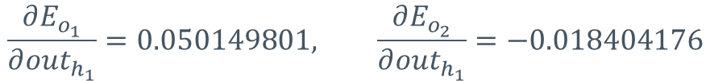


Backward Propagation to Update w1
Hidden layer
$$i_{1}$$
$$w_{1}$$
$$net$$
$$out$$
$$o_{1}$$
$$E_{o_{1}}$$
$$\frac{∂E_{total}}{∂w_{1}}=\frac{∂E_{total}}{∂{out}_{h_{1}}}∗\frac{∂{out}_{h_{1}}}{∂{net}_{h_{1}}}∗\frac{∂{net}_{h_{1}}}{∂w_{1}}$$
$$\frac{∂E_{total}}{∂{out}_{h_{1}}}=\frac{∂E_{o_{1}}}{∂{out}_{h_{1}}}+\frac{∂E_{o_{2}}}{∂{net}_{h_{1}}}$$
$$i_{2}$$
$$h_{2}$$
$$o_{2}$$
$$E_{o_{2}}$$
$$b_{1}$$
$$b_{2}$$
$$E_{total}=E_{o_{1}}+E_{o_{2}}$$
$$\frac{∂E_{o_{1}}}{∂{out}_{h_{1}}}=0.050149801, \frac{∂E_{o_{2}}}{∂{out}_{h_{1}}}=−0.018404176$$
$$\frac{∂E_{total}}{∂{out}_{h_{1}}}=\frac{∂E_{o_{1}}}{∂{out}_{h_{1}}}+\frac{∂E_{o_{2}}}{∂{net}_{h_{1}}}=0.050149801+\left(−0.01\text{8404176} \right)=0.031745625$$

Slide 23
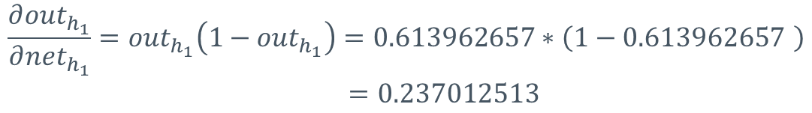


Backward Propagation to Update w1
Hidden layer
$$i_{1}$$
$$w_{1}$$
$$net$$
$$out$$
$$o_{1}$$
$$E_{o_{1}}$$
$$\frac{∂E_{total}}{∂w_{1}}=\frac{∂E_{total}}{∂{out}_{h_{1}}}∗\frac{∂{out}_{h_{1}}}{∂{net}_{h_{1}}}∗\frac{∂{net}_{h_{1}}}{∂w_{1}}$$
$$i_{2}$$
$$h_{2}$$
$$o_{2}$$
$$E_{o_{2}}$$
$$b_{1}$$
$$b_{2}$$
$$E_{total}=E_{o_{1}}+E_{o_{2}}$$
$${out}_{h_{1}}=\frac{1}{1+e^{−{net}_{h_{1}}}}$$
$$\frac{∂{out}_{h_{1}}}{∂{net}_{h_{1}}}={out}_{h_{1}}\left(1−{out}_{h_{1}}\right)=0.613962657∗\left(1−0.613962657 \right)$$
$$=0.237012513$$

Slide 24


Backward Propagation to Update w1
Hidden layer
$$i_{1}$$
$$w_{1}$$
$$net$$
$$out$$
$$o_{1}$$
$$E_{o_{1}}$$
$$\frac{∂E_{total}}{∂w_{1}}=\frac{∂E_{total}}{∂{out}_{h_{1}}}∗\frac{∂{out}_{h_{1}}}{∂{net}_{h_{1}}}∗\frac{∂{net}_{h_{1}}}{∂w_{1}}$$
$$i_{2}$$
$$h_{2}$$
$$o_{2}$$
$$E_{o_{2}}$$
$$b_{1}$$
$$b_{2}$$
$$E_{total}=E_{o_{1}}+E_{o_{2}}$$
$${net}_{h_{1}}=w_{1}∗i_{1}+w_{2}∗i_{2}+b_{1}∗1$$
$$\frac{∂{net}_{h_{1}}}{∂w_{1}}=i_{1}=0.1$$

Slide 25

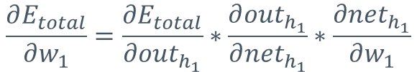


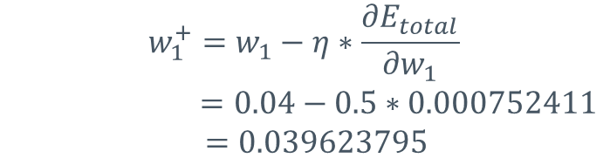
Backward Propagation to Update w1
Hidden layer
$$\frac{∂E_{total}}{∂w_{1}}=\frac{∂E_{total}}{∂{out}_{h_{1}}}∗\frac{∂{out}_{h_{1}}}{∂{net}_{h_{1}}}∗\frac{∂{net}_{h_{1}}}{∂w_{1}}$$
$$\frac{∂E_{total}}{∂w_{1}}=0.031745625∗0.237012513∗0.1=0.000752411$$
$$w_{1}^{+}=w_{1}−η∗\frac{∂E_{total}}{∂w_{1}}$$
$$=0.04−0.5∗0.000752411$$
$=0.039623795$
$$w_{2}^{+}=0.118118973$$
$$w_{3}^{+}=0.159635010$$
$$w_{4}^{+}=0.078175051$$

Slide 26
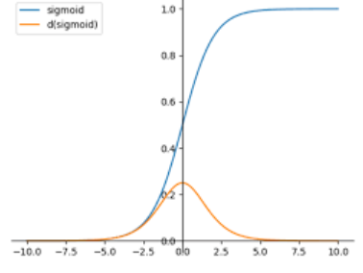
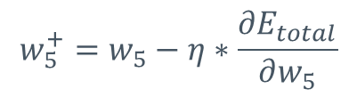

Gradient Vanishing
Update weight
Gradient Vanishing
Derivative of sigmoid is lower than 0.25
$$w_{5}^{+}=w_{5}−η∗\frac{∂E_{total}}{∂w_{5}}$$
Gradient
$$\frac{∂E_{total}}{∂w_{5}}=\frac{∂E_{total}}{∂{out}_{o_{1}}}∗\frac{∂{out}_{o_{1}}}{∂{net}_{o_{1}}}∗\frac{∂{net}_{o_{1}}}{∂w_{5}}$$
activation

Slide 27
Gradient Vanishing
Use Relu as Activation function (after Derivation only 0 or 1)
Small Layers
Redesign the network structure
ResNet or others
Do not use deep learning

Slide 28
How to Design A Good Neural Network Model

Slide 29
The Hyper Parameters
Dimensions
The number of neurons in each layer
Can be different in each layer
Numbers of layers
How depth is your model
Activation function
Linear: ReLu
Non-linear: Sigmoid, tanh
The bias in each layer

Slide 30
How Many Random Variables in Neural Networks
Consider a neural network
10 layers
100 nodes in each layer
1 bias in each layer
1 layer has 10100 parameters
100*100+100
10 layers has 101000 parameters
10100*10

Slide 31
The More Random Variables The Better?
More random variables can represent more latent information
Too many random variables will lead overfitting
Too fit to some special cases

Slide 32
How to Prevent Overfitting
Decrease your random variables
Decrease your dimensions or layers
May incur some errors
Increase your training data
Very difficult in practice
Dropout some variables
Let some variables not be trained in the training phase
Still in use in the testing phase

Slide 33
How Much Training Data We Need
10~30 times data to train random variables
we need 1010000 ~ 3030000 data to train 101000 variables
Few data may not be able to train a good model
Some variables may not be trained well

Slide 34


More Hyper Parameters
Learning rate
How many updates of the weight via gradients
Batch size
How many input data in each iteration
Epoch [epək]
How many times of passing the training data in the model
divide
Batch size
=size of each part
A training dataset

Slide 35

The Difference Between Iteration and Epoch
input
$$hidden layer$$
output
input
$$hidden layer$$
output
One iteration
input
$$hidden layer$$
output
input
$$hidden layer$$
output
One epoch

Slide 36
Hyper Parameters
Data set size = Iteration * Batch size （1 Epoch）
Iteration = （Data set size / Batch size）* Epoch
Batch size is large, it considers more data, resulting in more accurate corrections. However, each iteration takes longer, leading to fewer advancements towards the minima.
A smaller batch size, it considers only local data, causing directional biases in corrections. Yet, because each iteration involves less data, there is a chance to make more corrections within the same time frame.

Slide 37

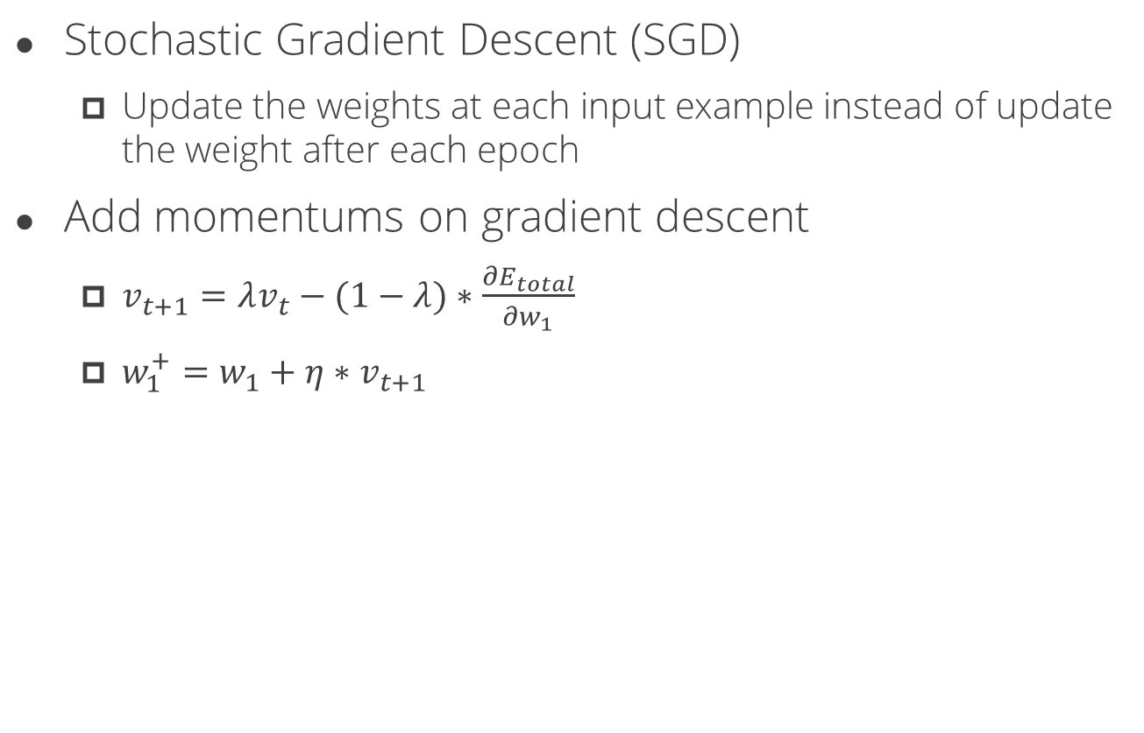
Different Way to Optimize Neural Networks
Stochastic Gradient Descent (SGD)
Update the weights at each input example instead of update the weight after each epoch
Add momentums on gradient descent
$v_{t+1}=λv_{t}−(1−λ)∗\frac{∂E_{total}}{∂w_{1}}$
$w_{1}^{+}=w_{1}+η∗v_{t+1}$
$$∇$$
momentum

Slide 38
Another Research Area on Neural Networks
Transfer Learning
Share the Neural Networks in similar domain
Weight transferring
Teacher Networks
Neural Network reasoning
Explain the reasons of each parameter

Slide 39
The Advanced Neural Networks
Convolutional Neural Networks (CNNs)
Image processing or image recognition
Recurrent Neural Networks (RNNs)
Time series prediction or language models
Long Short Term Memories (LSTMs)
The advanced RNNs to record long term data
AutoEncoders
Objects representation or object embedding
Generative Adversarial Networks (GANs)
Creativity tasks

